Slide 1
Unit 201: Health and safety in building services engineering
Accident and emergency procedures

Slide 2
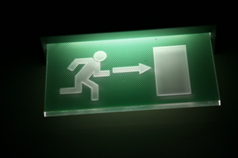
Accident & emergency procedures
This session deals briefly with the procedure which should be followed when an emergency situation occurs in the worksite.
Note: Always attend safety briefings and updates provided by your company.

Slide 3
Accident & emergency procedures
Know your company’s procedures for summoning emergency services.
Do you know your nearest contact point for where you are working?
Remember: time is essential. You do not have time to walk around looking for someone.
Use your mobile phone to summon help in an emergency; do not spend time walking around the site looking for a phone.

Slide 4
Accident & emergency procedures
Information that the emergency services will require includes:
Service you require (fire, police or ambulance)
Where you are calling from (address of site)
nature of emergency
exact location of the emergency
Anyone injured
your name, address and phone number
Refer to the internet for other suggestions: type ‘Calling 999’ into a search engine, e.g. Google.

Slide 5
Accident & emergency procedures
Understand how and when to set off an alarm.
Know and recognise the alarm signal.
Know escape routes on your construction site.
Be aware of the emergency meeting points on site.

Slide 6
Accident & emergency procedures
Procedures for handling injuries
If you discover someone who has sustained injuries the following procedure must be carried out:
make self safe
make area safe
administer first aid where appropriate
contact emergency services
contact nominated first aid person
contact supervisor.

Slide 7
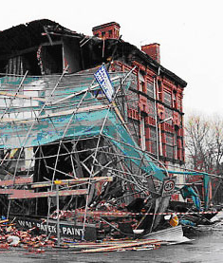
Accident & emergency procedures
RIDDOR
What must be reported?
deaths and injuries
occupational diseases
dangerous occurrences
gas incidents.

Slide 8
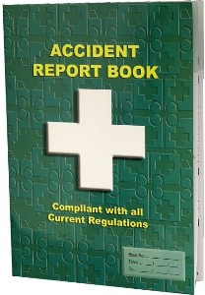
Accident & emergency procedures
Accident book
What details should be included in the accident book?
The appropriate details to include are:
name and address of injured person
date and time of accident
location of accident
cause and nature of injury
name and address of person recording the details.

Slide 9
First Aid facilities
The minimum first-aid provision on any work site is:
a suitably stocked first-aid kit
an appointed person to take charge of first-aid arrangements
information for employees about first-aid arrangements.

Slide 10
First Aid facilities
As a guide, where work activities involve low-level hazards, a minimum stock of first-aid items would be:
a leaflet giving general guidance on first aid
individually wrapped sterile plasters (of assorted sizes)
sterile eye pads
individually wrapped triangular bandages, preferably sterile;
safety pins
large, individually wrapped, sterile, unmedicated wound dressings
medium-sized, individually wrapped, sterile, unmedicated wound dressings
disposable gloves.

Slide 11
Unit 201: Health and safety in building services engineering
The End

